Slide 1
Corporate Income Tax
Sebastian James
World Bank

Slide 2
Business Accounting Practical Session

Slide 3
Requirements
Please use the interactive website financial statement calculator http://www.a-systems.net/financial-statement/

Slide 4
Balance Sheet (Beginning of Year 1)
Your Company was financed by Equity of $100,000 and Debt of $50,000
Loan will be repaid over time and interest will be deducted
Interest rate on Debt is 8%
You then used the moneys to buy Assets
Equipment $40,000 (depreciation 10%)
(Hint: Note that there will be Accumulated Depreciation at the end of the year)
What is the balancing item?

Slide 5
Income and Expenses (Accrual Basis)
First Build your inventory
Total Inventory bought is $60,000 bought in cash
Note if Inventory of bought in credit 8% is automatically deducted as interest)
Your Company made Sales (what is the impact on the P&L Account and the Balance Sheet)
Cash Sales of $80,000 during the year
Credit Sales of $20,000 during the year
Note: Cost of Goods Sold is 40% of Sales (i.e., gross margin is 60%) and when a Sale is made, it is automatically taken out of the Inventory and deducted as purchases
Your Operating Expenses was $20,000
Salary was $15,000
Office supplies $5,000
Your Non-Operating Income/Expenses were
Rent expense $2,000
Hint: include the Depreciation Expenses
You paid back a loan of $12,500 out of which 8% includes interest
Calculate your Net Income/Profit
Adjust Your Balance Sheet (What is the Balancing entry?)

Slide 6
Additional Exercises - Balance Sheet Impact
You bought new Equipment worth $10,000
Machinery is depreciated at the rate of 10% straight-line
For tax purposes the machinery is allowed to be depreciated at 20% straight line (what are the implications?)
A client of yours is not likely to pay you $5,000 as they have gone out of business during the year
Tax rules state that you need to wait at least 2 years before you can write off a debt

Slide 7
Tax Credits and Payments
Prepare your Balance sheet
Prepare your Income for
Financial purposes
Tax purposes
What parts go to the Balance Sheet ?
What would your Cash Flow Statement look like?

Slide 8
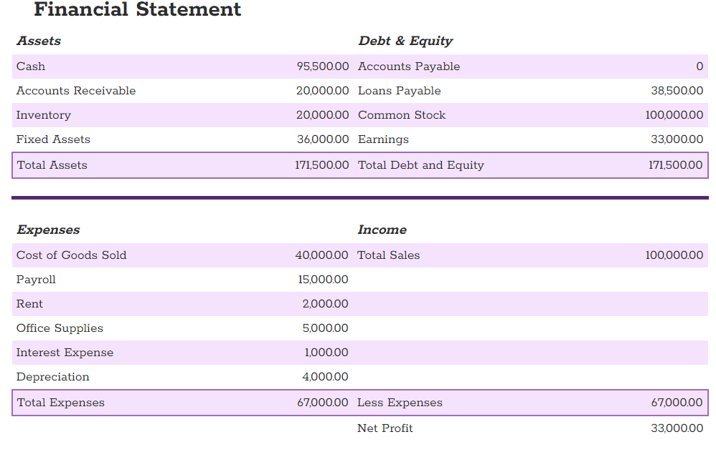


Solution

Slide 9
Outline
Taxable persons
Sources of income
Corporate income and tax rates
Cost of goods sold
Depreciation allowances
Financing costs
Overheads
Treatment of losses
Capital gains

Slide 10
Corporate Income Tax
Corporations and their taxation are treated as legal entities or legal persons separate from their owners.
Why are Corporations taxed as they are not living persons?
Issues of integration of corporate with personal income tax for resident owners and harmonization of tax with foreign jurisdiction for owners of non-resident corporations become relevant
The taxation of income from Corporations is fundamentally no different from the taxation of any other kind of business income
Even individuals could earn business Income and would be taxed just like corporations except that corporations could have an additional step that they distribute their post taxed income to their shareholders as dividend
Further Corporations don’t earn employment Income

Slide 11
Business Income
Definition of business income: Using the same definition as personal income from the uses side of income:
Income = Consumption + Change in net worth
Consumption = payment of dividends (in the case of corporations)
Change in net worth = retained earnings + capital gains/losses on assets and liabilities.
However, post taxed incomes of Corporation when distributed to shareholders as dividend are taxed again in the hands of the receiver
Retained earnings are post-taxed incomes that are not distributed to shareholders but retained for future investments.
Value of the Corporation (market value of all its shares) should be equal to the present value of all future incomes that it generates (including assets it owns when sold on liquidation)

Slide 12
Business income as viewed by an Accountant

Slide 13
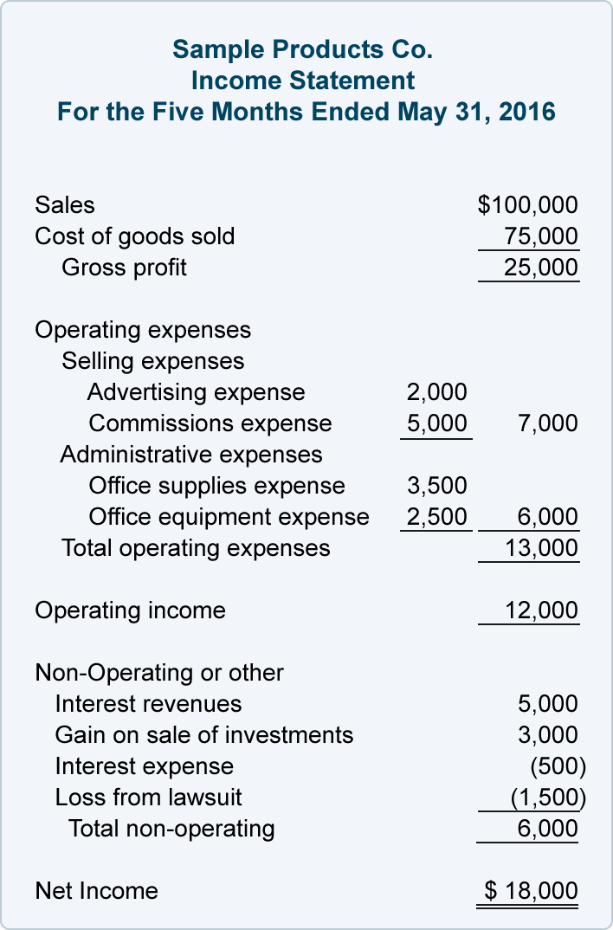
Income Statement Example
Source: Accounting Coach.com

Slide 14
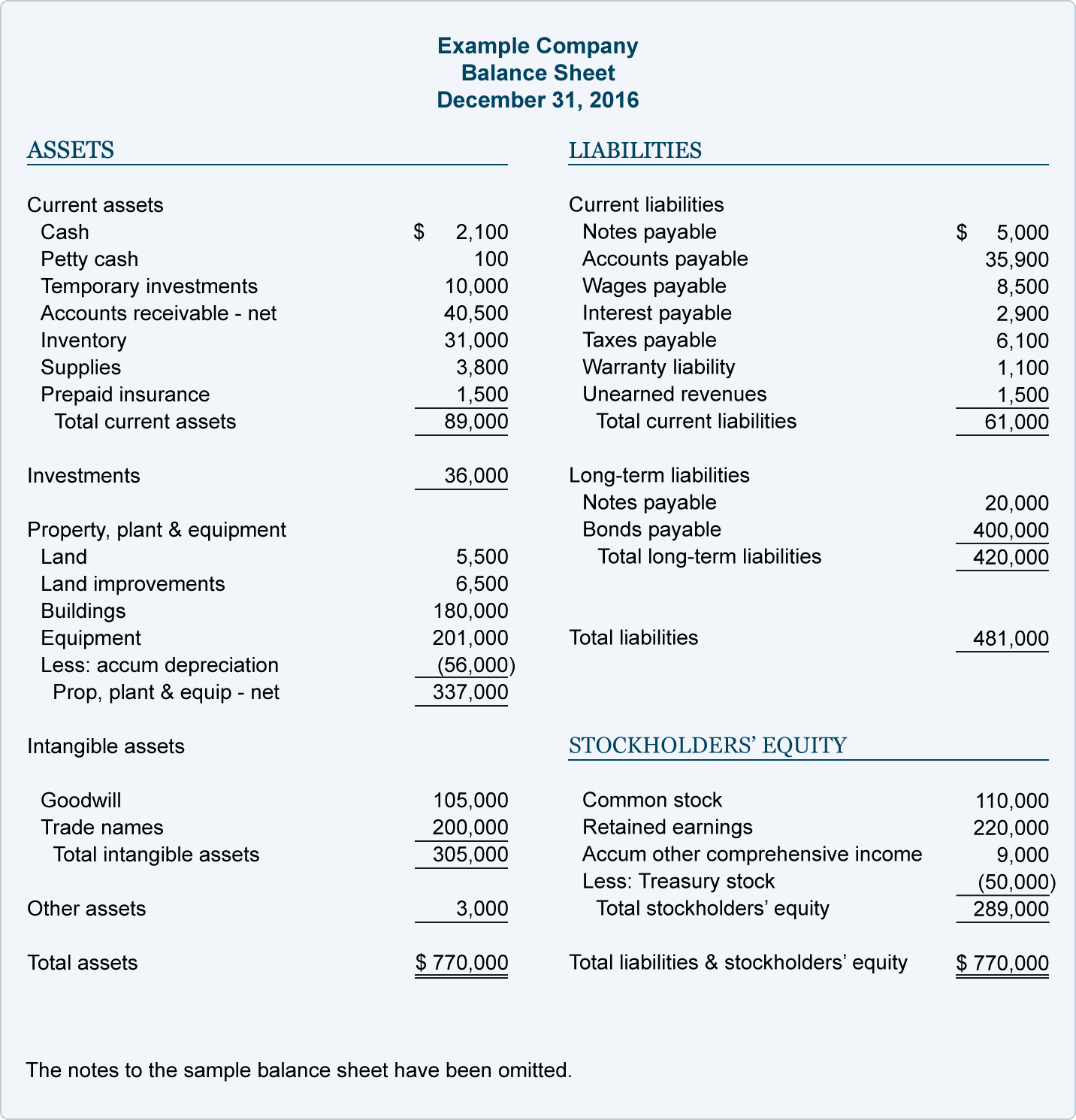
Balance Sheet Example
Source: Accounting Coach.com
Notes:
What is 'Accumulated Other Comprehensive Income'
Accumulated other comprehensive income (OCI) is a line item in the shareholders' equity section of the balance sheet that includes income that is not reported in the income statement. Other comprehensive income includes unrealized gains and losses on certain types of investments, as well as gains or losses on pension funds and foreign currency transactions.
Read more: Accumulated Other Comprehensive Income Definition | Investopedia http://www.investopedia.com/terms/a/accumulatedother.asp#ixzz4ceMRAmOe
Treasury stock is a company's own stock that it has reacquired from shareholders. When a company buys back shares, the expenditure to repurchase the stock is recorded in a contra equity account. This is a balance sheet account that has a natural debit balance.

Slide 15
Business income as viewed by an economist

Slide 16
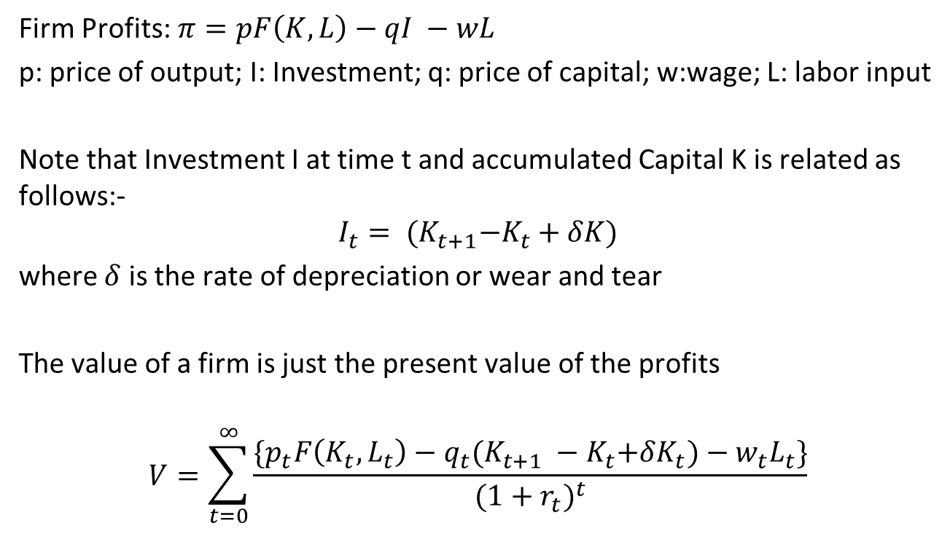
Taxation of the Firm

Slide 17
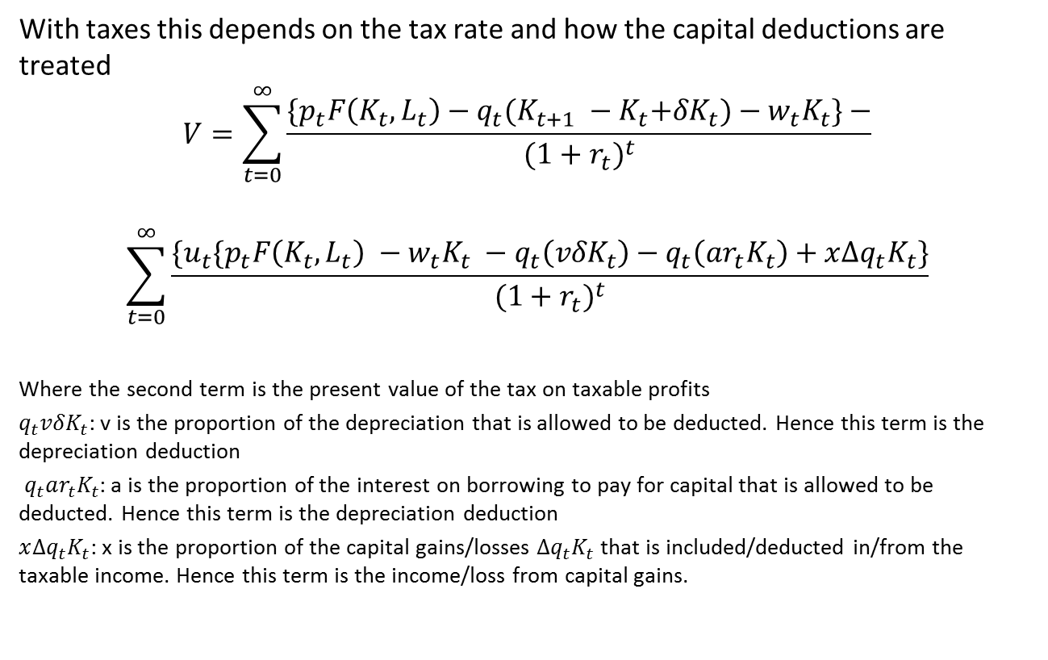
Taxation of the Firm

Slide 18
Business income as viewed by a lawyer

Slide 19
Profits and gains of business or profession
28. The following income shall be chargeable to income-tax under the head “Profits and gains of business or profession”,—
(i) the profits and gains of any business or profession which was carried on by the assessee at any time during the previous year;
(ii) any compensation or other payment due to or received by,—
(a) any person, by whatever name called, managing the whole or substantially the whole of the affairs of an Indian company, at or in connection with the termination of his management or the modification of the terms and conditions relating thereto;
(b) any person, by whatever name called, managing the whole or substantially the whole of the affairs in India of any other company, at or in connection with the termination of his office or the modification of the terms and conditions relating thereto;
(c) any person, by whatever name called, holding an agency in India for any part of the activities relating to the business of any other person, at or in connection with the termination of the agency or the modification of the terms and conditions relating thereto;
(iii) income derived by a trade, professional or similar association from specific services performed for its members.
¹[(iv) the value of any benefit or perquisite, whether convertible into money or not, arising from business or the exercise of a profession.]
Explanation 1.—The profits and gains of a business shall include the profits and gains of managing agency.
Explanation 2.—Where speculative transactions carried on by an assessee are of such a nature as to constitute a business, the business (hereinafter referred to as “speculation business”) shall be deemed to be distinct and separate from any other business.
29. Income from profits and gains of business or profession, how computed.- The income referred to in section 28 shall be computed in accordance with the provisions contained in sections 30 to 43D.

Slide 20
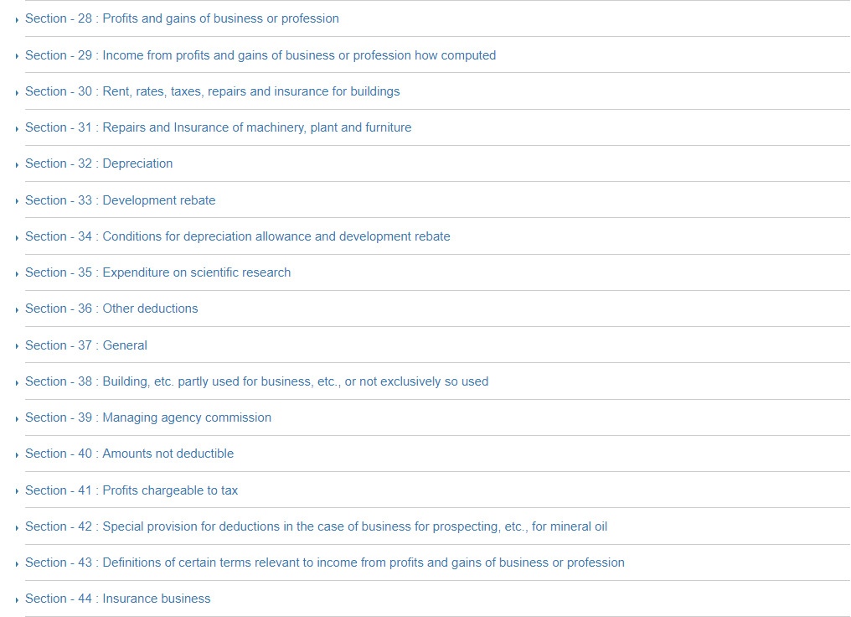

Slide 21
Business Income
In practice: Business Income is defined from the sources side in terms of revenues earned less the costs of earning income plus capital gains. Tax base or taxable income:
Generally, Taxable income = Sales revenue - cost of goods sold - depreciation allowances - financing costs - overheads.
Receipts from sales are “Revenue Receipts” which are recurring by nature (received again and again) and which are available for meeting all day-to-day expenses (revenue expenditure). Apart from sale proceeds of goods, revenue receipts also include receipt of interest payment, commission and rent received etc.; shown on credit side in profit loss account.
Receipts of non-recurring nature whose benefit is enjoyed over a long period are called "Capital Receipts", e.g. money brought into the business by the owner (capital invested), loan from bank, sale proceeds of fixed assets etc. Capital receipt is shown on the liabilities side of the Balance Sheet.

Slide 22
Various Accounting Practices
Financial or commercial accountancy is governed by both local and international accounting standards. Generally accepted accounting principles (GAAP) is the standard framework of guidelines for financial accounting used in any given jurisdiction. It includes the standards, conventions and rules that accountants follow in recording and summarizing and in the preparation of financial statements.
International Financial Reporting Standards (IFRS), on the other hand, is a set of accounting standards stating how particular types of transactions should be reported in financial statements. IFRS are issued by the International Accounting Standards Board (IASB). With IFRS becoming widespread, consistency in financial reporting has improved between global organizations.
Tax accounting rules are often different from the general financial accounting principles for a variety of reasons.

Slide 23
Tax Accounting for Business Income Taxation (1)
The simplest approach is to use the income that is obtained by using the standard Accounting principles.
However, tax laws in most cases use different rules to obtain taxable income
This usually is derived by starting from accounting Income and adding back those incomes that are considered taxable (and not included in the income side as per accounting principles) and removing those expenses that are not allowed by the tax law (but allowed by the accounting principles)
Examples of expenses not permitted for deduction from income:-
provision of bad debts and other taxes, fines and penalties; certain expenditures which government may like to discourage such as entertainment expenses or which are not incurred “wholly and exclusively” for business purposes.

Slide 24
Tax Accounting for Business Income Taxation (2)
Income tax laws and accounting also usually restrict the valuation conventions that may be employed in measuring income (discussed later)
The main purpose of these specific provisions in income tax law is to make the measure of income for tax purposes more objective than it may be in commercial accounts that are meant to serve other purposes.
Similarly, income tax laws must provide for specific deductions not necessarily in commercial accountings of business such as any deduction for losses brought forward from earlier years.

Slide 25
Tax Rates and Their Declining Trend
Corporate income tax (CIT) rate typically set at rate at or less than top MTR under PIT
Global investment competition has been driving down CIT rates over past three decades by about 20 percentage points to rates at or below 30% in most countries.
Many countries now have lower CIT rate on corporate earnings (first layer tax) and charge a secondary tax or final withholding tax on distributed dividends (secondary tax).
Secondary (ST) or withholding tax is also important to ensure that corporate dividends are ultimately taxed at same rate as top PIT MTR. For example if CIT rate =25% and top PIT MTR =40%, then ST = (40%-25%)/(1-25%) = 20% closes the gap between the top PIT MTR and CIT rate on dividends distributed to individuals.

Slide 26
Average statutory rates in High Income countries dropped from 28% in 2003 to 20% in 2021
Plus “Tax havens” – no tax, but no production; and special treaty treatments

Slide 27
Average statutory rates in Eastern Europe has dropped to nearly 15% on the back of the Flat Tax
Sub-Saharan Africa remained nearly steady.

Slide 28
Cost of goods sold(1)
(a) Cost of goods sold (COGS): Issue of inventory valuation: If prices are changing with time (real or inflationary), method of calculating COGS needs to be specific and well defined in order to define costs of items withdrawn from inventory used in making sale.
(b) Methods normally used:
- First In First Out or FIFO method: the oldest inventories taken as the COGS.
- Last In First Out or LIFO method: the cost of raw materials purchased last is the COGS.
Average cost
Illustrations: Assume price increase of 10% each period and a corporate tax of 40%.

Slide 29
COGS (FIFO)
FIFO
Years 1 2 3 4
Sales 200 220 242
Purchases 100 110 121
COGS 100 110 121
Taxable Income 100 110 121
Tax liability (nominal) 40 44 48.4
Tax liability (real) 36.36 36.36 36.36
PV of tax
(@ 8% discount rate) 33.67 31.18 28.87
PV of total tax liability 93.72

Slide 30
COGS (LIFO)
LIFO
Sales 200 220 242
Purchases 100 110 121
COGS 110 121 100
Taxable Income 90 99 142
Tax liability (nominal) 36 39.6 56.8
Tax liability (real) 32.73 32.73 42.67
PV of tax
(@ 8% discount rate) 30.31 28.06 33.87
PV of total tax liability 92.24
(normally even lower if inventory liquidation deferred for longer)

Slide 31
COGS: LIFO vs FIFO
Conclusions:
a) With FIFO, company pays more taxes as it uses old prices in costs. Timing of payment is important.
b) In LIFO, tax liability low in initial years. Tax liability high in the last year, when the company may be closing down because of bad times or poor business operations. LIFO accentuates cycles – taxes relatively higher in downturns when draw down inventories.
• In most countries, a corporation allowed to choose either FIFO or LIFO; some restrict to FIFO. LIFO is desirable in high inflation economies; FIFO in low inflation economies, also to avoid high taxes in cyclical downturns
• Sometimes a mixture may be used – average cost method.

Slide 32
Depreciation allowance
Depreciation (Capital Consumption) Allowance:
Reflects the wear and tear of capital (plant, machinery, building) during production process and is therefore a cost of earning income. (Unexpected changes in future profitability of use of asset lead to capital gains and losses)
• Ideally, should use economic depreciation. Difficult to determine, especially if company uses a large number of machines and equipment. Also requires price adjustments to current level rather than historical cost base.
• Following four methods often used:
(i) Straight line depreciation
(ii) Declining balance (also “sum of digits”)
(iii) Immediate expensing
(iv) At loss or realization

Slide 33
Depreciation methods (1)
(i) Straight line method: Based on the historical cost of the machine, life of the asset, and the estimated salvage value at the end of life, a uniform rate of depreciation calculated.
C = historical cost
SV = Salvage value (often assumed to be zero)
n = life of asset (tables for different machinery/ equipment usually provided)
D = annual depreciation = (C - SV) / n
• Requires asset-by-asset depreciation accounts
• Often used for large long-lived assets such as buildings

Slide 34
Depreciation methods (2)
(ii) Declining balance: Provides an allowance equal to constant proportion of outstanding undepreciated balance of assets.
C = historical cost;
d = depreciation rate;
Annual depreciation allowance =C*d, in first year,
=C*(1-d)*d in second year,
=C*(1-d)²*d, in third year, etc.
• For economic life of asset of n years, set d=2/n (“double declining balance” method) then present value of straight line and declining balance tax reductions are approximately equal
• Studies show economic depreciation follows declining balance
• Can allow pooling of all assets in same depreciation rate class rather than asset by asset depreciation accounts. New purchases in asset class added to pool, sales of assets subtracted from pool. Depreciation rate for class of assets applied to pool. Simplification makes pooled declining balance popular tax reform measure.

Slide 35
Depreciation methods (3)
(iii) Immediate expensing: The whole of the capital cost depreciated in the first year. Equivalent to declining balance with d = 100%. Form of accelerated depreciation used as investment incentive (more later under investment incentives.)
(iv) At realization or loss: All depreciation allowances allowed at the time of realization (asset sale) or loss.
Illustrations
Taxable income before depreciation $100, and cost of asset purchased in year 1 for $90 (historical cost) with three years of life.

Slide 36
Straight line method
Years 1 2 3
(i) Straight line method
Taxable income before
depreciation allowance 100 100 100
Depreciation 30 30 30
Taxable income 70 70 70
Tax liability 28 28 28
PV of tax 25.5 23.1 21.0
(@ 10% discount rate)
PV of total tax liability 69.64

Slide 37
Declining balance
(ii) Declining balance method
Taxable income before
depreciation allowance 100 100 100
Depreciation (d=2/3) 60 20 6.7
Taxable income 40 80 93.3
Tax liability 16 32 37.3
PV of tax (@ 10% discount) 14.5 26.4 28.0
PV of total tax liability 69.0

Slide 38
Immediate expensing
(iii) Immediate expensing method
Taxable income before
depreciation allowance 100 100 100
Depreciation 90
Taxable income 10 100 100
Tax liability 4 40 40
PV of tax 3.64 33.1 30.0
(@ 10% discount rate)
PV of total tax liability 66.75

Slide 39
At realization
(iv) At loss or realization method
Taxable income before
depreciation allowance 100 100 100
Depreciation 0 0 90
Taxable income 100 100 10
Tax liability 40 40 4
PV of tax 36.36 33.06 3.01
(@ 10% discount rate)
PV of total tax liability 72.43

Slide 40
Comparison of methods
• Total deduction is the same in each cases (except declining balance requires more than 3 years to get full deduction), but the difference is in timing.
• The present value of taxes paid from lowest to highest
i. immediate expensing
ii. declining balance (depending on rate)
iii. straight line method
at realization or loss method.
• Depreciation typically based on the historical cost of capital and not on the replacement cost or current value of asset. Value of asset generally not adjusted for changes in price in subsequent years. Some countries allow for inflation adjustments (more later). Important to distinguish between capital/gains losses and depreciation.

Slide 41
Financing costs (1)
Financing costs:
Interest expenses on loans used to purchase assets (including working capital) used for earning income deducted as only taxing return to equity holders.
Interest should include accrued cost of discounts on corporate bonds (add original issue discounts and subtract original issue premiums).
Realized or accrued foreign exchange losses on repayment of principal may be allowed on foreign currency debts.
With a higher debt (thinner capitalization), tax liability of corporation lower.
Illustration
For a corporation with 100% equity financing of $200, three years of life and a corporate tax rate of 50%, tax liability is as follows:

Slide 42
Financing costs (2)
100 % equity
Years 1 2 3
Taxable income 50 50 50
Tax liability 25 25 25
PV of tax 23.1 21.4 19.8
(@ 8% discount rate)
PV of total tax liability 64.42

Slide 43
Financing costs (3)
Alternatively, with a 50% loan of 100 at 10%
50 % equity and 50% debt
Taxable income 50 50 50
Interest expense (10%) 10 10 10
Taxable income 40 40 40
Tax liability 20 20 20
PV of tax 18.51 17.15 15.88
(@ 8% discount rate)
PV of total tax liability 51.53

Slide 44
Overheads
Overheads:
Expenses on general administration (legal, accounting, etc.), advertising, public relations business, promotion activities, or business research, planning and development not directly attributable to specific sales
Amortization of soft costs: Examples: exploration and development costs in mining, marketing cost for life insurance policy
• A deduction not justified as a cost of doing business is a subsidy given by society to a taxpayer given that the taxpayer or employee is then typically the beneficiary of the expenditure and value should be taxable as employee fringe benefit.

Slide 45
Treatment of losses
Ideally, income and losses should be treated symmetrically: tax compensation for losses. Particularly important for risky projects
• If symmetrical treatment of income and losses, then taxation leaves expected net-of-tax return unchanged (but still lower), but reduces variance in net-of-tax return or lowers risk. Effectively government shares risk with investor.
• If government taxes income, but under compensates losses, then expected net-of-tax return declines and variance or risk increases (relative to symmetrical case).
• In addition, in most sectors equity holders demand a systematic risk premium to cover non-diversifiable market risks (CAPM). This systematic risk premium or cost of risk is taxed. This raises the effective tax rate compared to a risk free investment by
t/(1-t)* premium.
Government effectively is taking disproportionate share of upside gains relative to loss offsets and effective tax rate is increased.
• In practice, profits and capital gains tax tend to take higher share of gains than share of losses.
.

Slide 46
Mechanisms for loss offsets
• Loss off-set, i.e., through reduction of taxable income of a company in its profit making activities by an amount equivalent to losses in a risky project in the same year. Also consolidation of tax accounts across companies, otherwise companies merge to realize tax losses. Problem for start-up companies – delayed loss realization.
• Alternatively, the loss incurred allowed to be off-set against its profits in an earlier or later period through loss carry backwards or loss carry forward. Often a trade off between allowing consolidation and length of loss carry forwards – where no consolidation, loss carry forwards sometimes indefinite. LCF absorption may be restricted to share of taxable income in future years
• Both loss off-set and loss carry forward or carry backward provisions are a form of income averaging.

Slide 47
With loss offset and excessive investment incentives, negative effective tax rate possible
With loss carry forward absorbing losses, effective tax rate falls depending on length of carry forward and inflation rate

Slide 48
US cuts Fed CIT rate from 35% to 21% but limits loss carryovers to cut tax revenue cost
Prior to 2018: 20 year loss carryforward and two year loss carryback (5 for farm income)
Losses generated 2018 and subsequent years:
Corporations: No loss carryback (2 for farm income) and indefinite loss carryforward but limited to 80% of on income in subsequent years. (Property and casualty insurance income remain as per pre-2018)
Non-corporates: $500K limit on carryforwards deductible and excess carried forward indefinitely, but limited to 80% of non-business income
Results:
Increased tax compliance complexity
Lower CIT rate, but offset by greater variance in taxes as lower tax value of losses. Expected tax rate is raised above statutory rate

Slide 49
Asset Value
Owning an Asset gives one the right to the future incomes from that Asset. That implies that the value of the asset is related to the future income flows.
$100 today is not the same as $100 in one year. Why?
Because $100 today would generate interest (say 6%) and become $100*6% + $100 = $100*(1+6%) = $106 in a year’s time. That means $106 in one year is equal to $100 today i.e., = 106/(1+6%).
or $1 in 1 year is equal to $1/(1+r%) today.
In two year’s time, $100 would become $100*(1+6%) after year 1 and $100*(1+6%)*(1+6%) after year 2.
i.e., $100*(1+6%)^2 in 2 years time is equal to $100 today.
or $1 in 2 years time is equal to $1/(1+r%)^2 today.
Therefore, the total value of the asset is the sum of present value of the income flows.
Asset Value increases when the expectation of the future flows of incomes change.

Slide 50
Asset Value (2)
If b is the income stream, then
Year | Income Stream | Present Value
1 | b | b/(1+r)
2 | b | b/(1+r)²
3 | b | b/(1+r)³
4 | b | b/(1+r)⁴
5 | b | b/(1+r)⁵
6 | b | b/(1+r)⁶
Therefore,
Value of the Asset = b/(1+r) + b/(1+r)² + b/(1+r)³ + b/(1+r)⁴ + …..∞
(This is a Geometric Series, the sum* is)
[b/(1+r)]/[1-1/(1+r)] = b/r
* b/(1-r) = b + br + br ² + br ³ + br ⁴ + …..∞

Slide 51
Capital gains tax (1)
A tax on the appreciation in the value of an asset, which is a change in net worth and is, therefore, a part of taxable income.
This tax also deters people from converting profits into investments (current into capital income) and thereby avoiding income tax payments.
The general formula: t_{cg} * (A_{t} - A_{t-1}), where t_{cg} is capital gains tax rate and (A_{t}-A_{t-1} ) is the appreciation and A_{t-1} is the cost base. Improvements to asset add to cost base but depreciation is deducted.
Capital gains are typically taxed when realized, not when accrued. Capital losses typically have to be taken against capital gains rather than against ordinary income. Unused capital losses are carried forward until gains are realized.

Slide 52
Capital gains tax (2)
The net worth of a company decreases due to depreciation of assets. Depreciation is allowed as a deduction from taxable income. By contrast, appreciation in the value of assets is an addition to net worth and is subjected to capital gains tax.
For depreciable assets, many tax systems require any gain on sale of asset which realizes upon sale more than the depreciated value of the asset to be recognized as income (even where no capital gains tax): recaptured income = A_{t}-(A*_{t-1}-D_{t}) where D_{t} is amount of depreciation claimed and A*_{t-1} is the acquisition cost. This is important where investment incentives are offered increasing D_{t}. Where pooled depreciation is used, if sale of asset makes remaining value of pool go negative, this is typically recaptured and recognized as income.

Slide 53
Capital gains tax (3)
Equity value of a company will capitalize any shifts in expected future after-tax profits from changes in tax structure, productivity, sales or costs. This happens continuously where shares are traded publicly. As a result, capital gains taxes can result in double taxation of these changes in after-tax profits, even before they arise and get reflected in the subsequent company profits and national accounts. Considerations such as these lead to pressures to moderate or remove capital gains taxes on publicly traded shares.
Capital gains do not represent incremental current economic activity; they reflect changing prices of existing assets such that one person’s gain is another person’s loss. Hence, capital gains taxes are not a significant source of revenues. Capital gains should result in net income tax when high income persons capture gains.

Slide 54
Capital gains tax (4)
In the case of non-traded closely-held companies capital gains taxation can be important to prevent the avoidance of dividend taxation. If a company is sold with retained earnings instead of distributing out dividends and paying any taxation applicable to these distributions, then without a capital gains tax the dividend taxation can be avoided as the owner can capture the value of the retained earnings through the sale of the company. But there are other mechanisms for preventing untaxed distributions such as Dividend Tax Account (see Tax Integration.)

